Slide 1
How to Present your Artwork and Get Connected
Gallery Director and Professor, Museum Studies
Alessandra Moctezuma
San Diego Mesa College

Slide 2
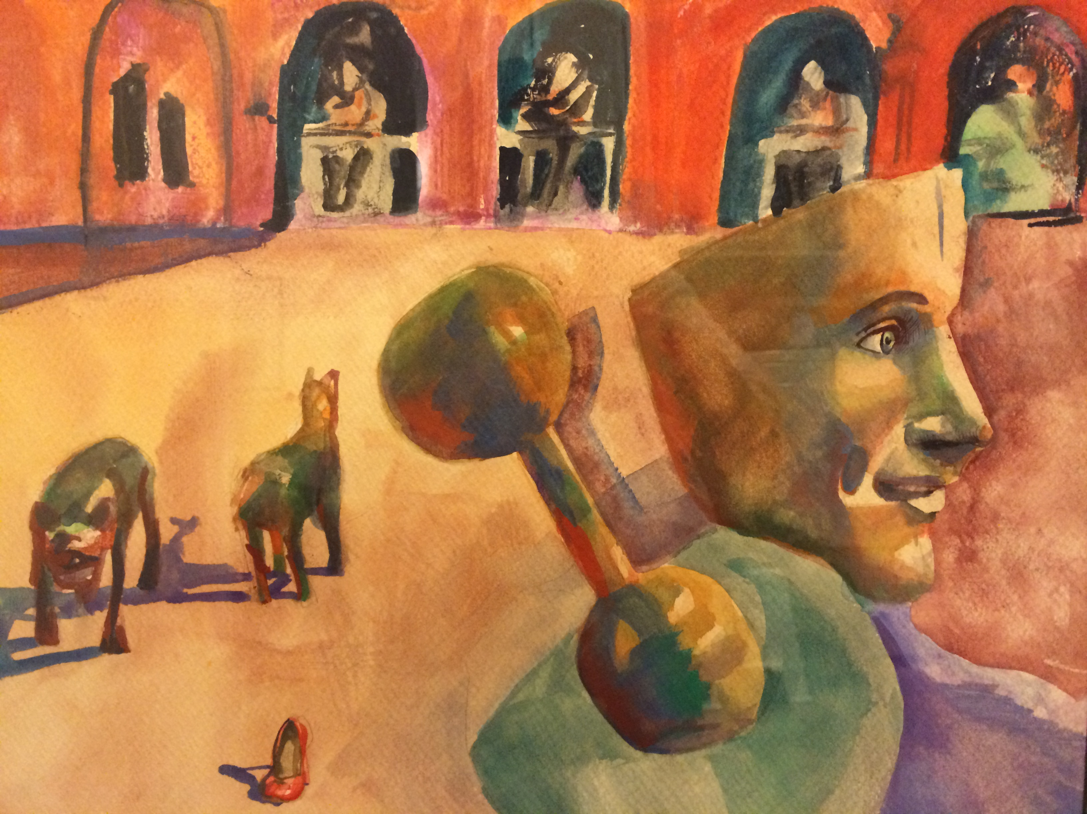
You’ve made your work now what?

Slide 3
Ways to get your work out of the studio and into the public:
Problem 1: A curator hears your name and wants to check out your work…
Best:
Website with art portfolio, bio, CV, contact info
At least:
Instagram page dedicated to your artwork
Facebook page dedicated to your artwork

Slide 4
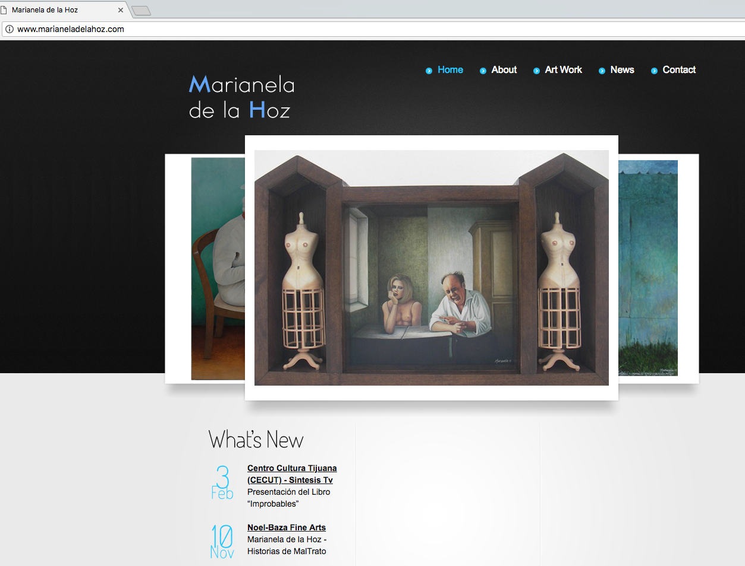
http://www.marianeladelahoz.com

Slide 5
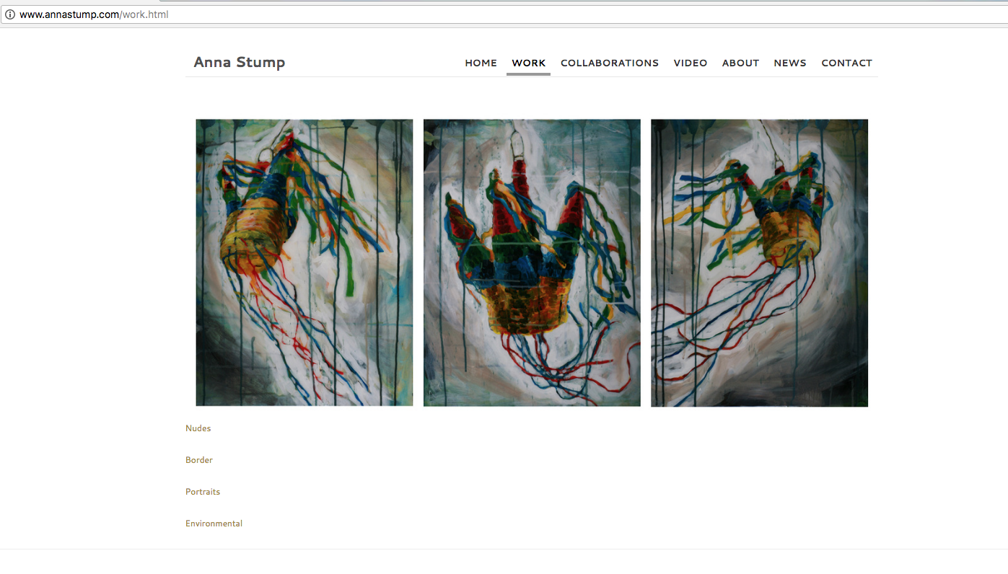
Portfolio: Anna Stump

Slide 6
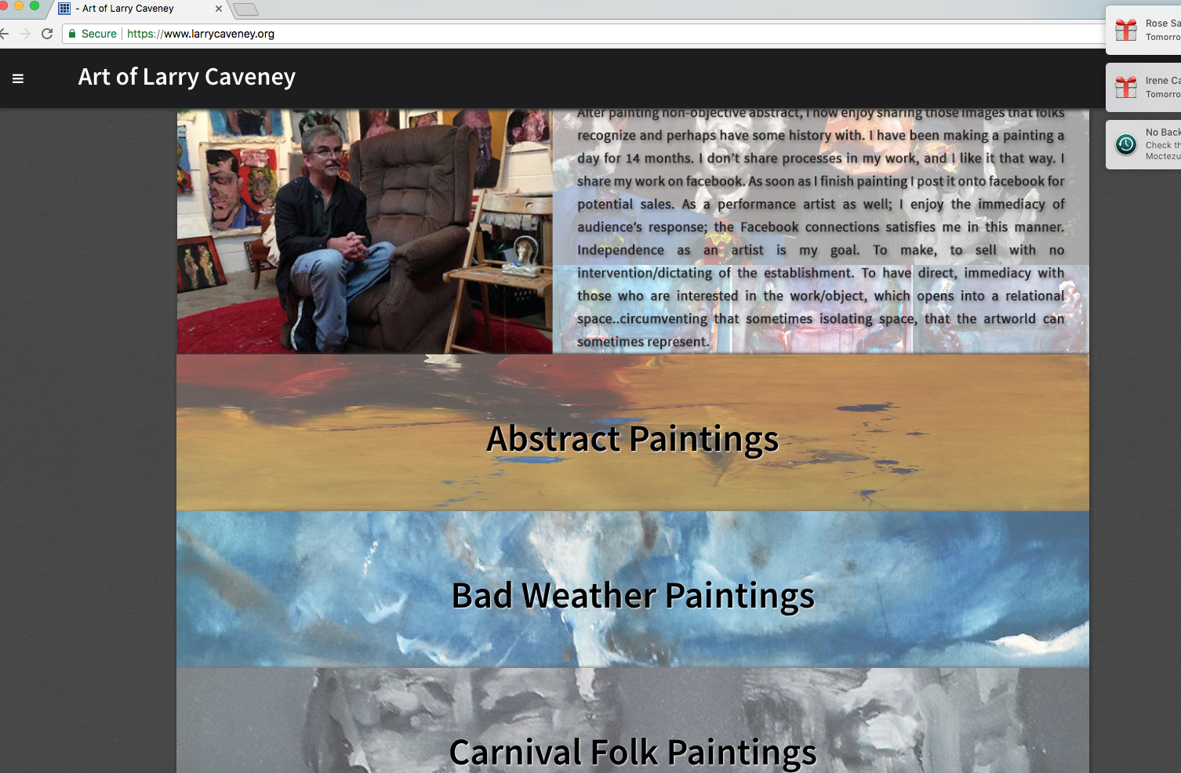
https://www.larrycaveney.org

Slide 7
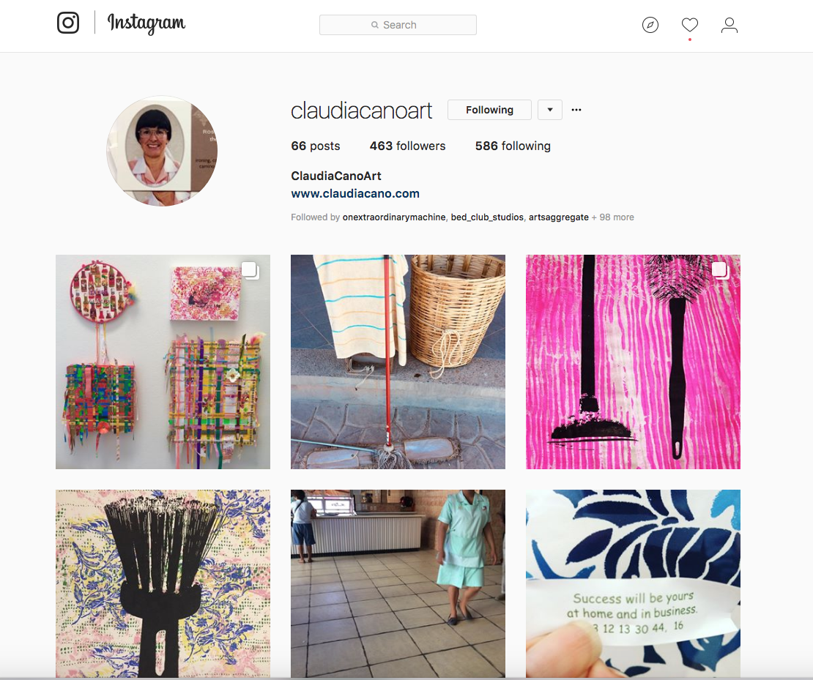
Some cool Instagram:

Slide 8
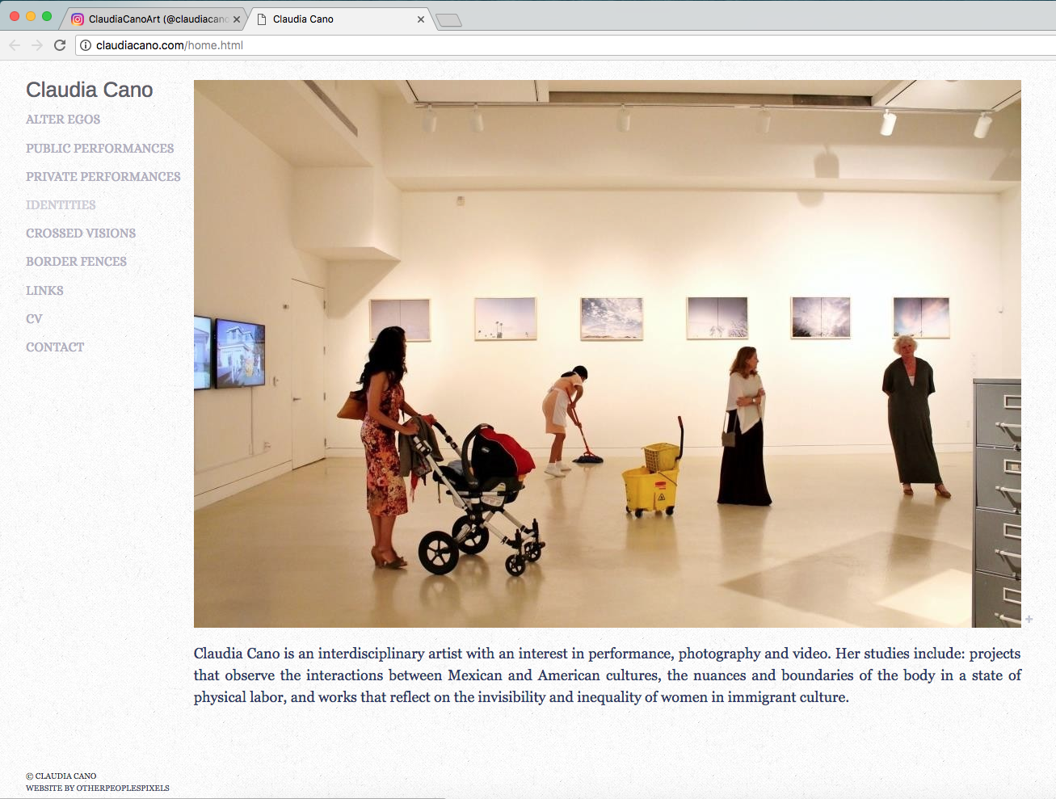
And her website:

Slide 9
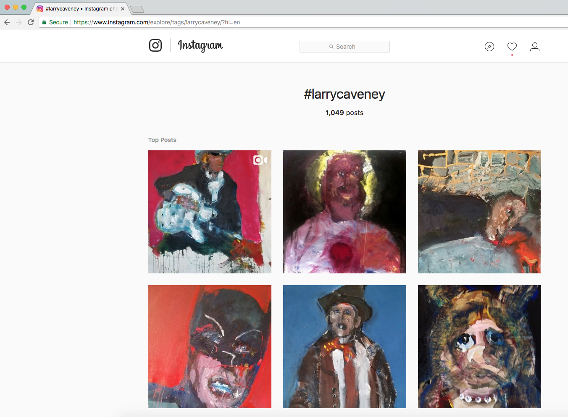
Some cool Instagram:

Slide 10
Get out of the studio and network! This is part of your ‘job’ as an artist.
Check out gallery/ college gallery and other art listings on San Diego Visual Arts Network, City Beat, KPBS Arts and Culture Calendar.
On Facebook Like the galleries/ college galleries and museums that you are interested in and look at their events pages.
Make an effort to go to some of the art openings, lectures and mingle! Get to meet the artists and curators, gallery directors.

Slide 11
Research and consider participating in juried exhibitions!
Make a list of annual juried exhibitions in your area: La Jolla Athenaeum, Artist Guild, Dia de la Mujer at The Front, Cannon Art Gallery, Escondido Municipal Gallery.
Look out for other Call for Artists on FB: San Diego Contemporary Arts Scene, San Diego Artists, Resources Opportunities and Online Community, Leticia Gomez Franco ArtsAccess
Consider fees? Are they reasonable and within your budget.

Slide 12
Make contact!
Proposal and Studio Visits
After you have attended art events at a gallery, community college gallery you will get to understand whether your work fits in that space.
Request a studio visit
Send in a proposal with an idea for an exhibition.
Sometimes a group exhibition might also be interesting. Work with other artists to generate a concept.

Slide 13
Before you contact a curator with a proposal or for a studio visit:
Make sure you have a solid concept/idea that you want to present through your artwork.
DO NOT just show a variety of works that are just explorations on different themes. This might seem amateurish.
For that SOLID CONCEPT have a good amount of artwork that shows that you have seriously developed your idea and have enough to show.

Slide 14
Images for media and sharing:
Make sure the photographs or your artwork are properly composed with good lighting.
Photograph the work straight on, with the camera lens parallel to the picture plane.
Fine to take pictures with an Iphone or other Smart Phone, it allows you to adjust light and color.
Make sure the image you post is representative of the artwork.

Slide 15
Difference between a bio and a C.V.
A bio is a written narrative about you in paragraph form. You might include aspects of your education and career and also what inspires you as an artist. Who collects your work and highlights of were you have shown.
A C.V. or Resume is a listing of your career accomplishments, much like a business resume. List: Group exhibitions, Solo exhibitions, Press, etc.

Slide 16
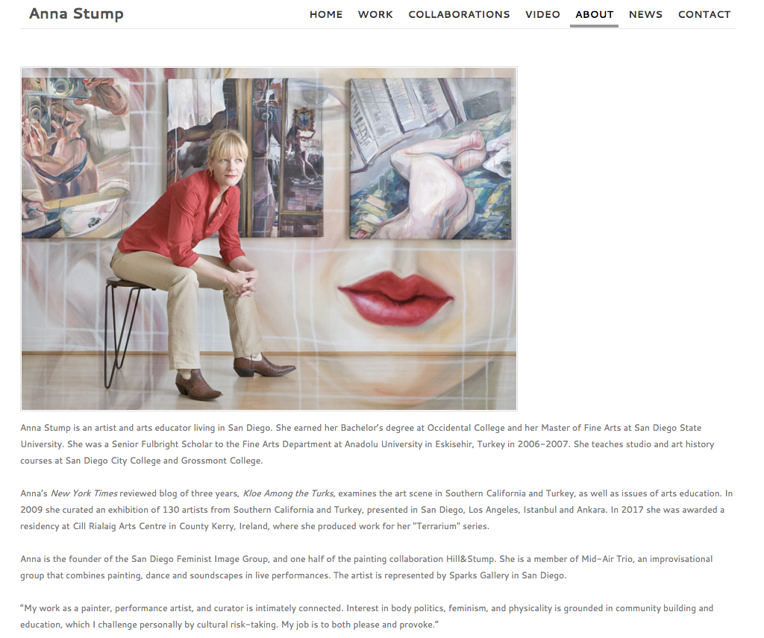
Example bio:

Slide 17
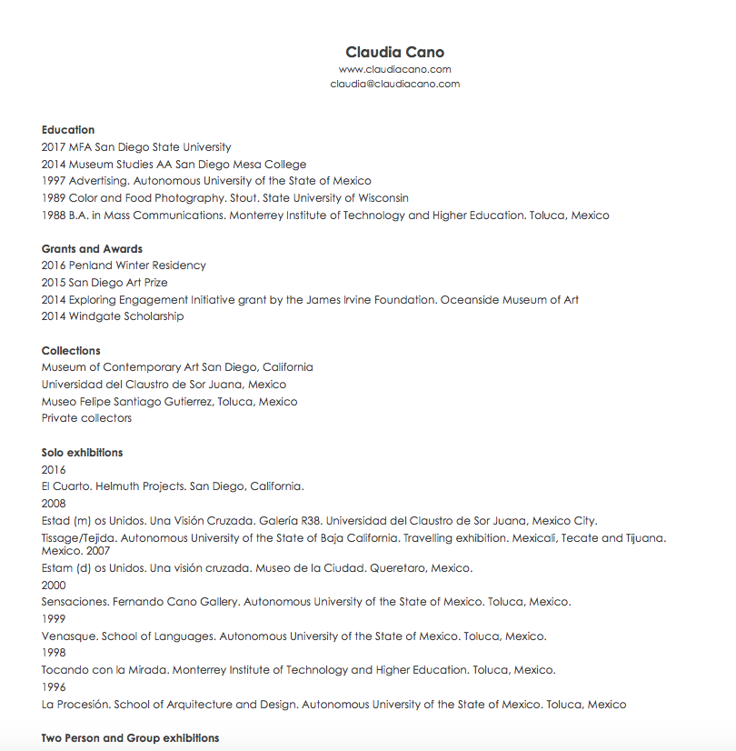
Example C.V. or Resume

Slide 18
Artist Statements are important:
An artist statement allows you to provide more information about your work. It can include:
Concept or ideas that you are exploring in your artwork.
Process and methods in creating your work.
Inspiration.

Slide 19
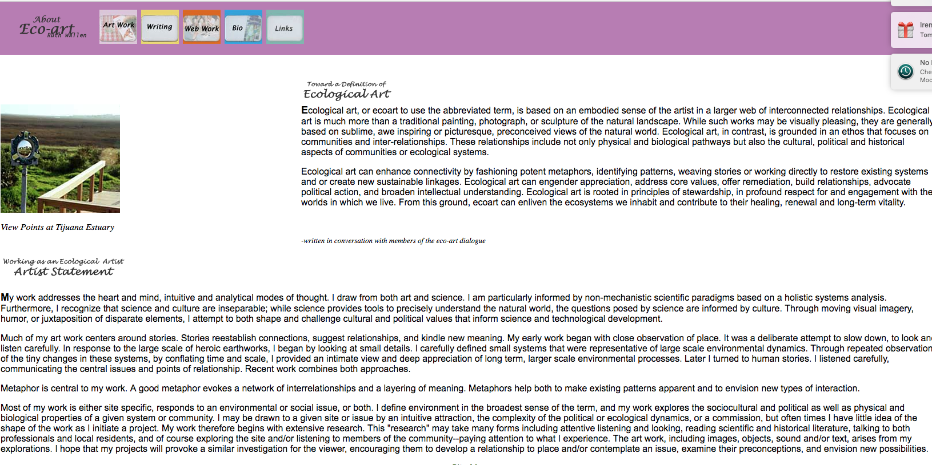
Sample Artist Statement

Slide 20
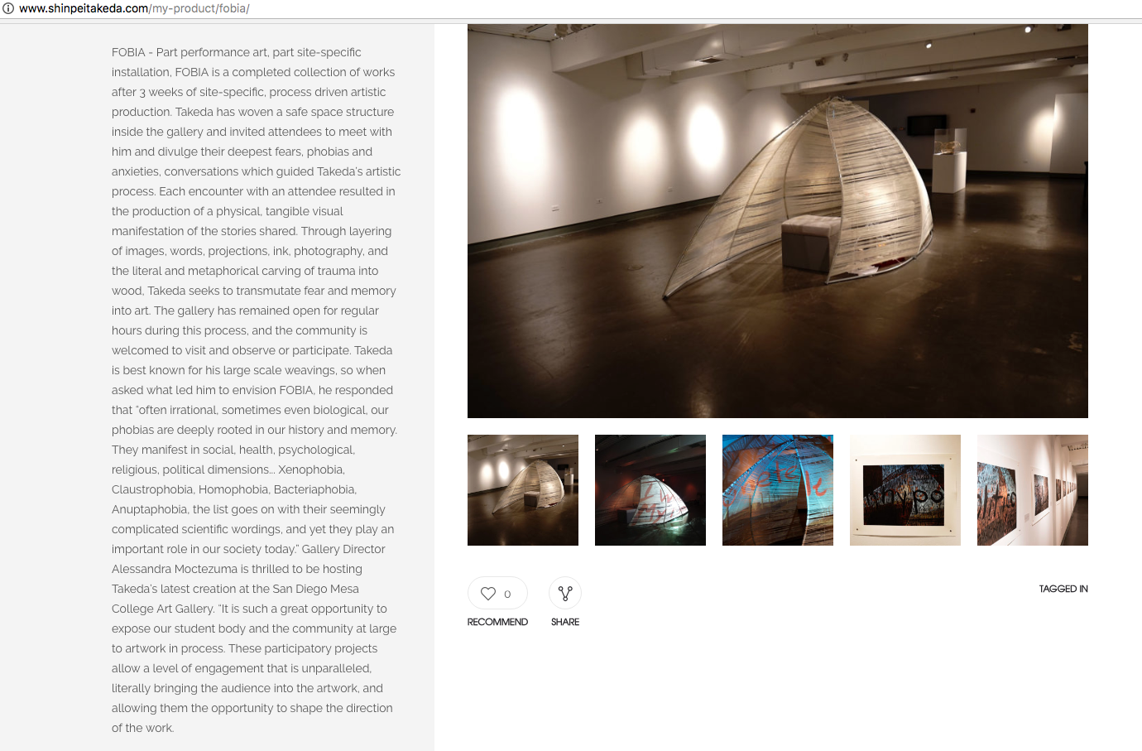
Artwork statement

